Slide 1
CNN
for Multi-class
Histopathology
Image Classification
Liran Hersh – 203955299
Asaf Darmon – 205404080
Noy Maman – 313594434
Karin Azulay – 316541549

Slide 2
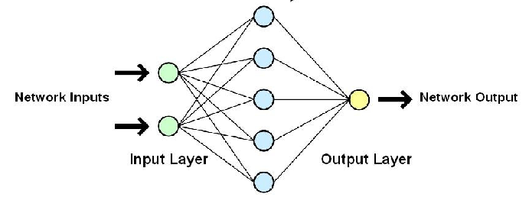
What is NN?
Neural Networks
Learning approach based on modeling adaptation in biological neural systems.
The neurons are organized in layers, connecting with weights between following layers.
Multilayer perceptron's fully connected , that is, each neuron in one layer is
connected to all neurons in the next layer

Slide 3
introduction
In recent years, the microscopes are being replaced by digital scanners.
Computer-aided diagnostic (CAD) systems can perform the diagnosis and classification of the diseases using WSI images.
Since the WSIs are very large in size, it is not easy for experts to diagnose disease types by looking at all patches.
The computer-aided diagnosis systems can overcome these problems.
In recent years, deep learning architectures, especially CNNs are the most successful type of methods has been applied to medical image analysis tasks such as detection and classification.

Slide 4
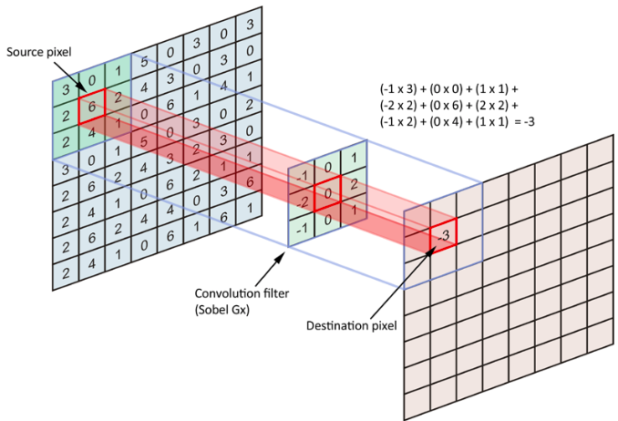
CNN
Convolution neural network
CNN is a deep neural network originally designed for image analysis.
CNN always contains two basic operations, named convolution and pooling.
Convolutional neural networks apply a filter to an input to create a feature map
that summarizes the presence of detected features in the input.

Slide 5
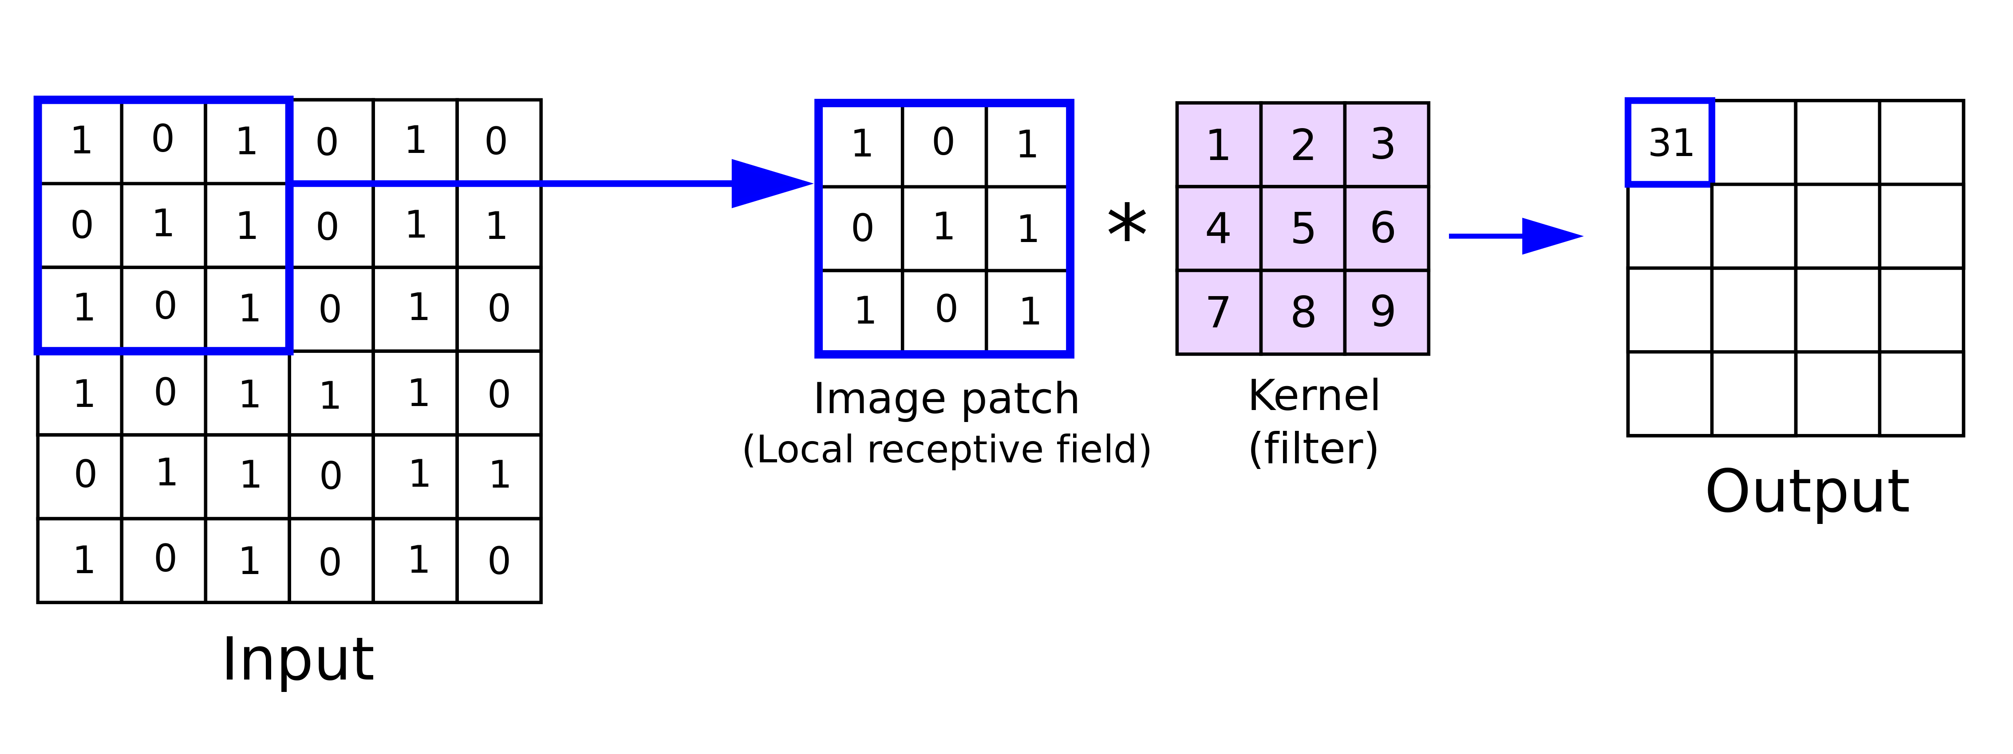
Convolution Operation
A convolutional layer contains a set of filters whose parameters need to be learned.
Each filter is convolved with the input volume to compute an activation map made of neurons.

Slide 6
Convolution Layer
As we can see here we have :
← Filter
Image →

Slide 7
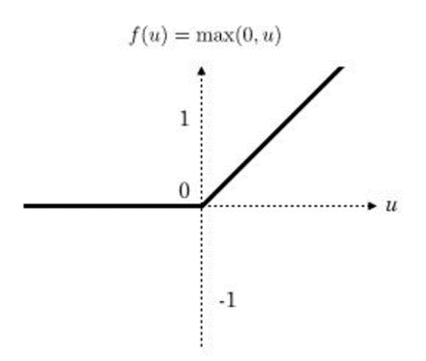
Rectified linear unit ReLU
It maps the resulting values

Slide 8
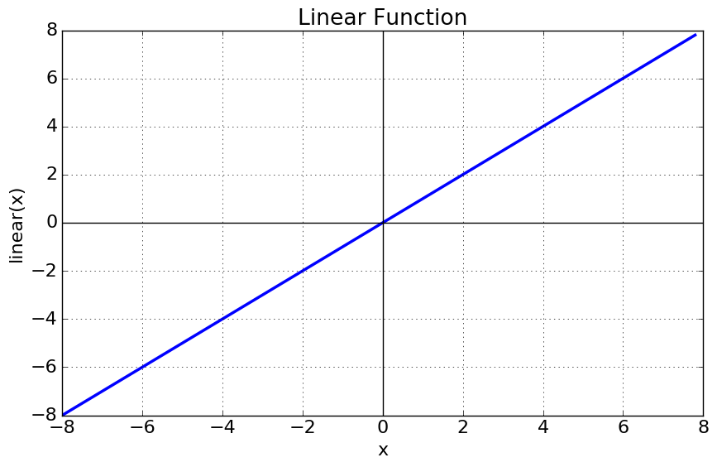
Rectified linear unit ReLU
Linear Activation Function
As you can see the function is a line or linear. Therefore, the output of the functions will not be confined between any range.

Slide 9
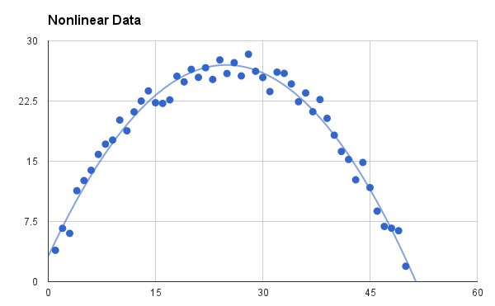
Rectified linear unit ReLU
Non-linear Activation Functions
It makes it easy for the model to generalize or adapt with variety of data and to differentiate between the output.

Slide 10
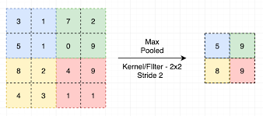
Pooling Operation
Pooling layers are used to reduce the dimensions of the feature maps.

Slide 11
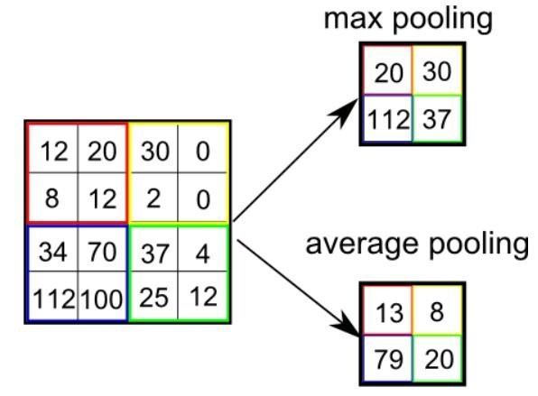
Pooling Operation
Max pooling and average pooling are the most common pooling operations
used in the CNN.
- Max pooling- takes the maximum value.
- Average pooling take the values average.

Slide 12
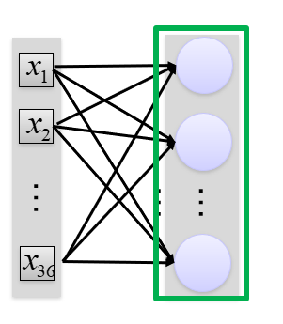
Fully Connected
Fully connected layer that takes the output of convolution/pooling and predicts
the best label to describe the image

Slide 13
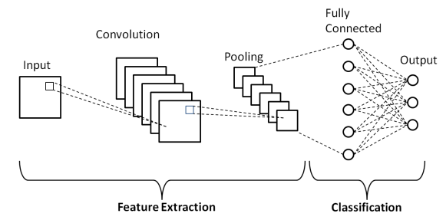
Explanation

Slide 14
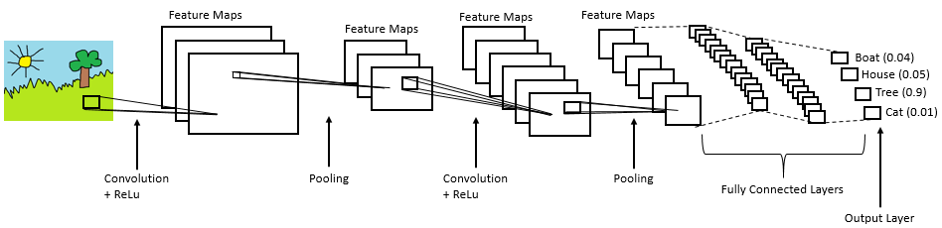
Explanation

Slide 15
Transfer learning
The basic premise of transfer learning is simple:
take a model trained on a large dataset and transfer its knowledge to a smaller dataset.
For object recognition with a CNN, we freeze the early convolutional layers of the network and only train the last few layers which make a prediction. The idea is the convolutional layers extract general, low-level features that are applicable across images — such as edges, patterns, gradients — and the later layers identify specific features within an image such as eyes or wheels.

Slide 16
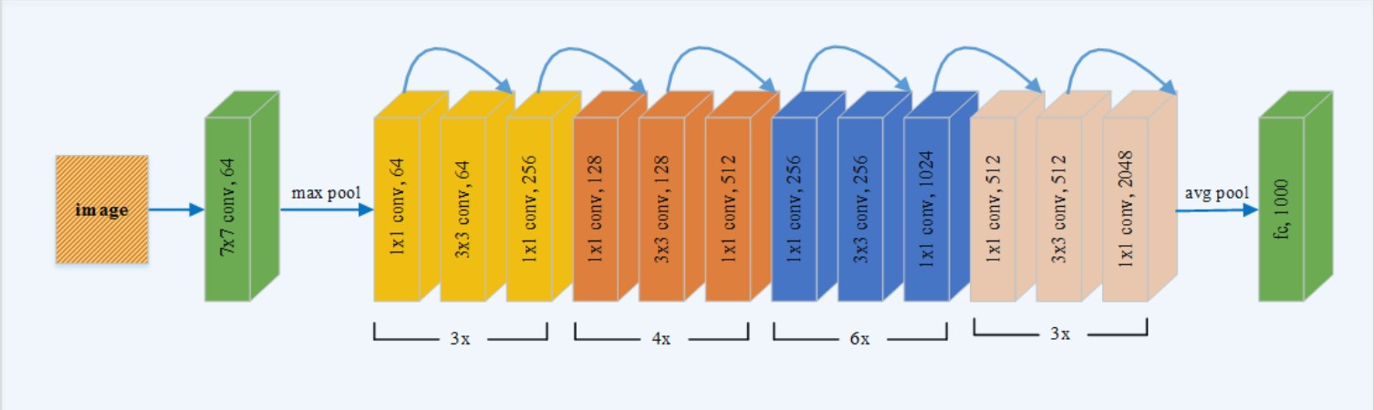
ResNet
ResNet is the short name for residual Network.

Slide 17
ResNet
Use Skip connection technique to enable very deep training network.
Can boost the performance of the model
The connections preserve the gained knowledge during training and speed up the training time of the model.

Slide 18



Comparison
GoogLeNet
ResNet Uses 152 layers while other CNN network is using much less. For example:
GoogleNet – 22 layers
AlexNet – 8 layers
VGGNet – 16 layers

Slide 19
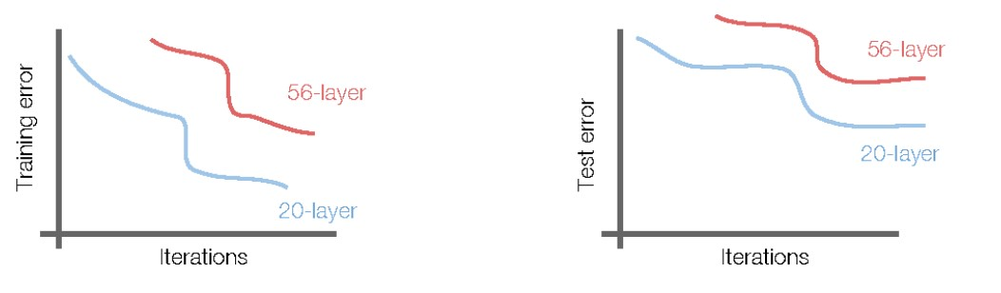
Layers comparison
The problem is an optimization problem, Very deep networks are harder to optimize.
Use network layers to fit residual mapping instead of directly trying to fit a desired underlying mapping.

Slide 20
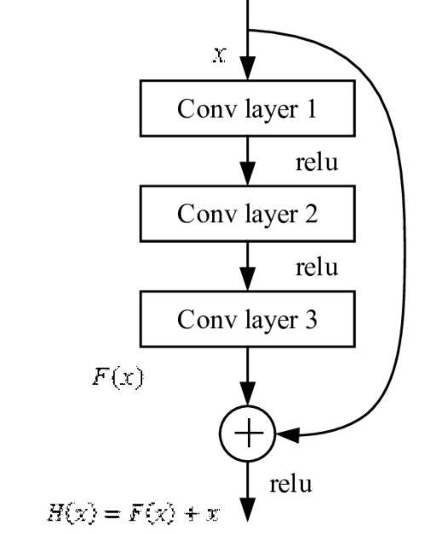
Skip connection
By adding skip connections, ResNet allow gradients to flow easily from layer to layer.
This helps to train really deep networks from the start even the lowest layer receives activations from the top layer.

Slide 21
ResNet50 VS DenseNet161
They are both pre-trained CNN architecture and classify histopathology images into 24 categories.
They take 80% images for training and 20% for validation set.
The performances of the proposed pre-trained CNN models are evaluated on the test set.
It takes a lot of time to pre-trained CNN and we should use advanced graphic card like Geforce 1080 GTX like the authors used.
ResNet50 – for color images with accuracy of 97.89%
DenseNet161 – for black and white images with accuracy of 98.87%

Slide 22
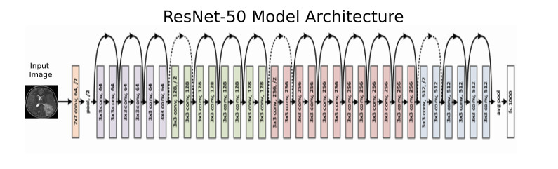
ResNet50
ResNet50 is a 50 layer Residual Network.

Slide 23


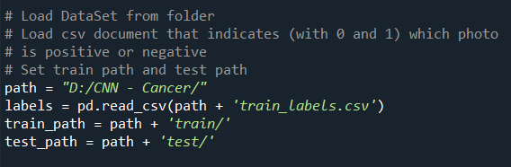
Code
https://www.kaggle.com/jtmurkz/keras-resnet50-0-96lb

Slide 24
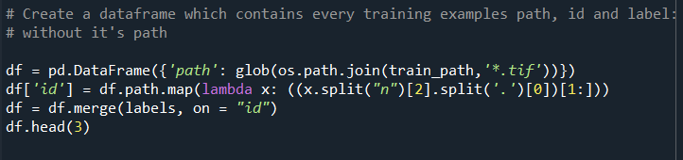
code

Slide 25
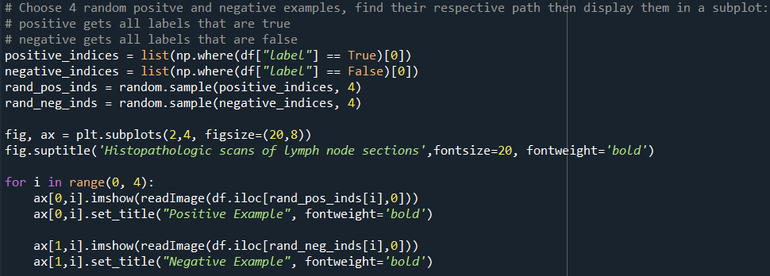
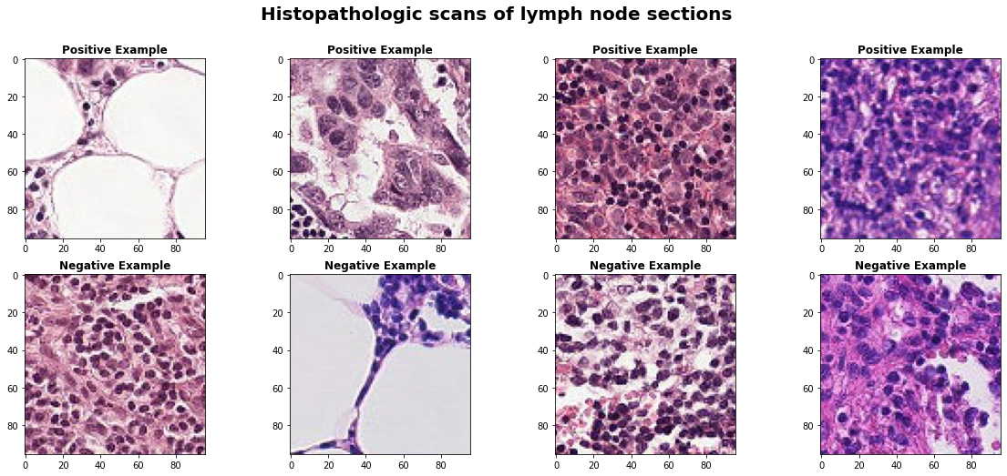
code

Slide 26
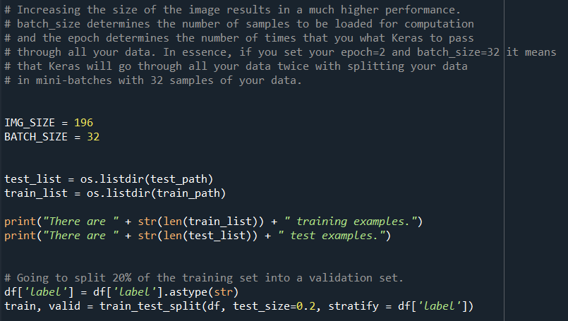
code

Slide 27
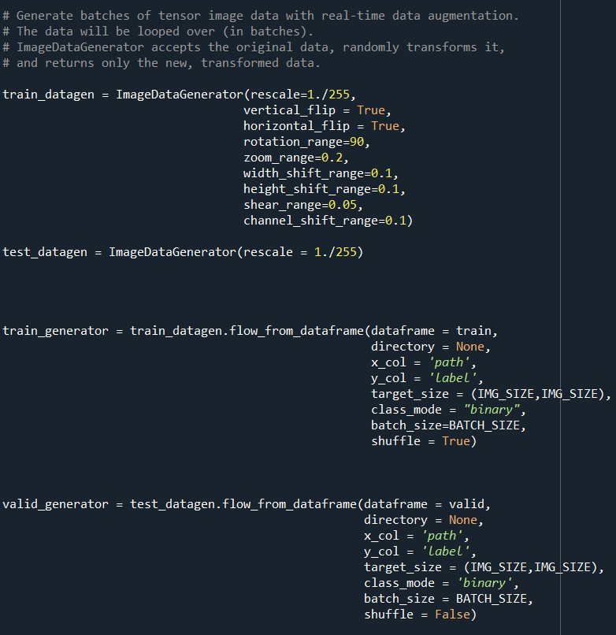
Code -
Preparing our model properties

Slide 28
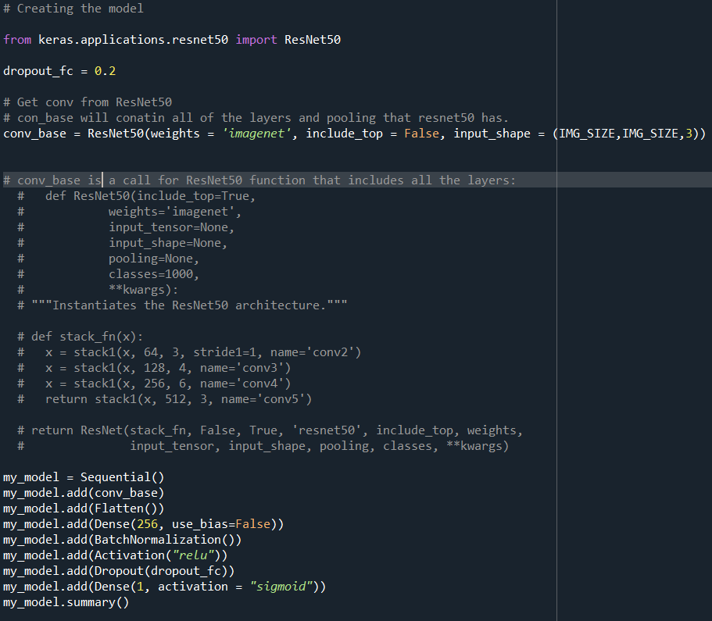
Code -
Preparing our model properties

Slide 29
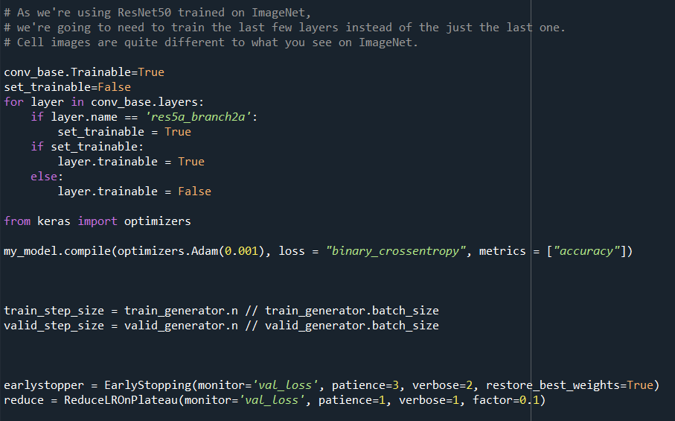
Code - Setting our model

Slide 30
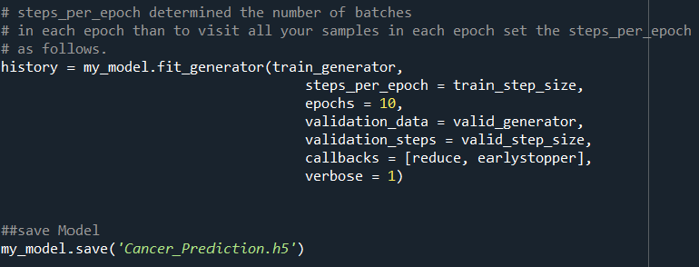
Code - Training our model

Slide 31
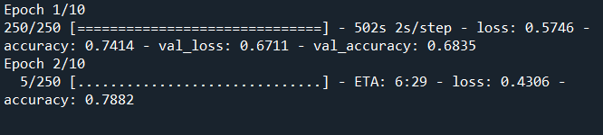
Code - Training process

Slide 32
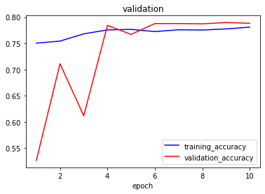
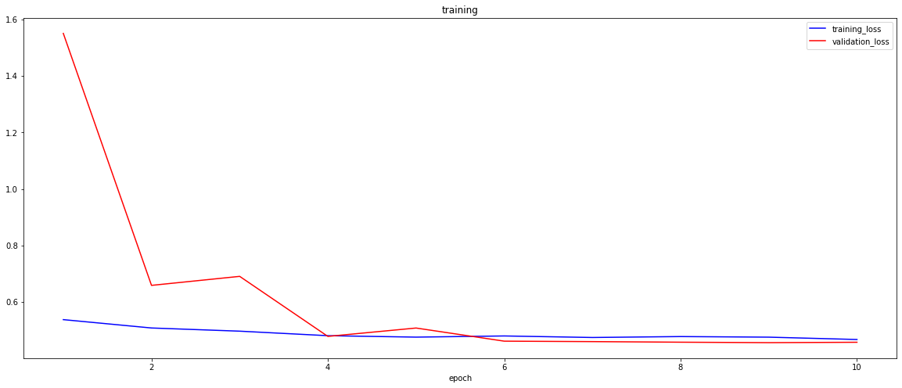
Training and validation graphs

Slide 33
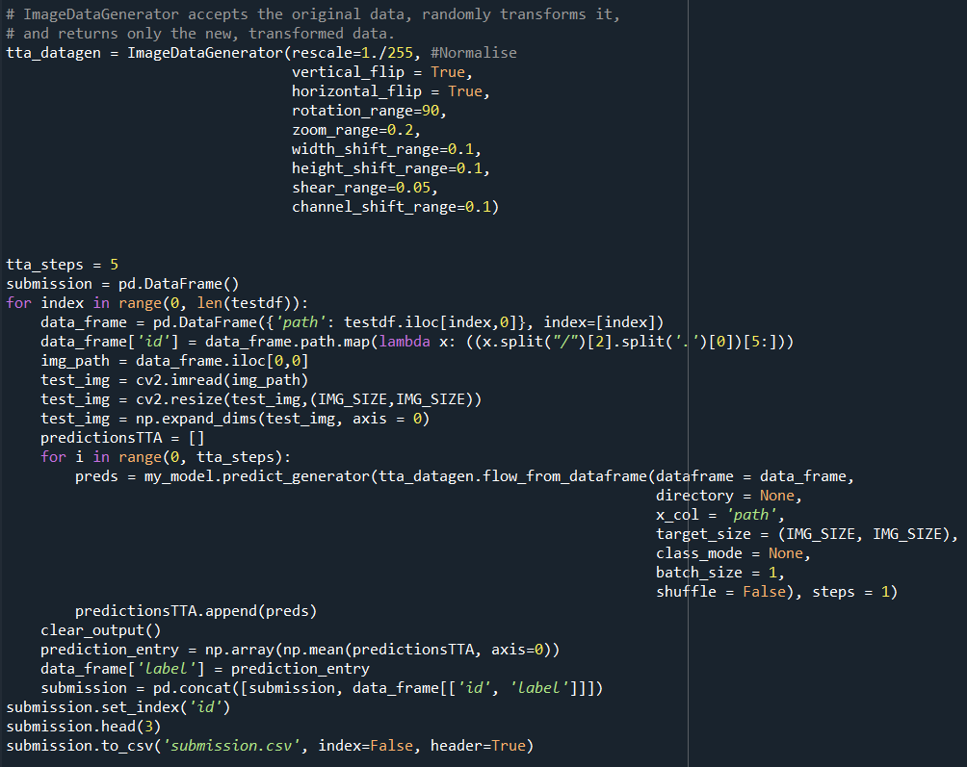
Testing process

Slide 34
Conclusion
The DenseNet-161 and ResNet-50 pre-trained models are employed to classify digital histopathology images into 24 categories.
The classification performance of pre-trained models is compared for the color and grayscale images.
The proposed DenseNet-161 model tested on grayscale images and obtained the best classification accuracy of 97.89% which outperforms the state-of-art methods. Additionally, the proposed ResNet-50 pre-trained model is tested on color images of Kimia Path24 dataset and achieved a classification accuracy of 98.87%

